Slide 1
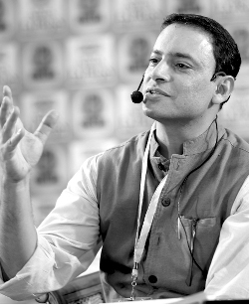
Story coach, Innovation consultant and Diversity champion, Ameen Haque is the founder of Storywallahs, a company that helps leaders and organisations leverage the power of stories. Storytelling is an essential skill, no matter what you do and Ameen helps you build that capability at your organisation.
Ameen Haque: "The Art of Business Storytelling"
Ameen Haque
Story coach
Bharat
mane

Slide 2
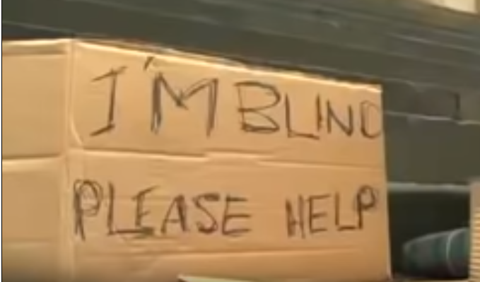

Bharat
https://www.youtube.com/watch?v=F8bm2llxxjU
mane
Notes:
Let’s watch a video

Slide 3

Decisions?
Bharat
mane
Notes:
We know that we have two sides of brain,
Logical thinking side
Emotional thinking
How do we make decisions when we are faced with choices, what is that one that makes us believe A versus B
Science has revelled us that almost all kinds of decisions, the emotional side of the brain is predominant and stories speak to emotions

Slide 4
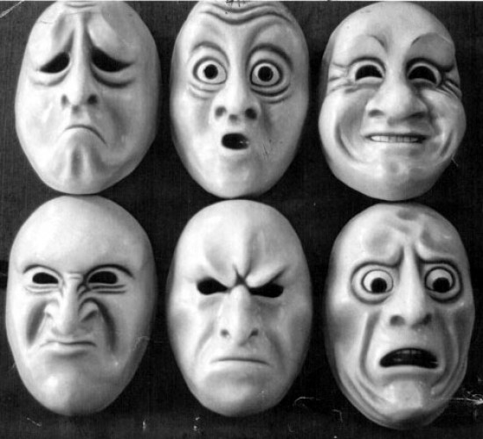
Stories speak to people’s emotions
Bharat
mane
Notes:
When we speak to people’s emotions, it gathers and results in higher response

Slide 5
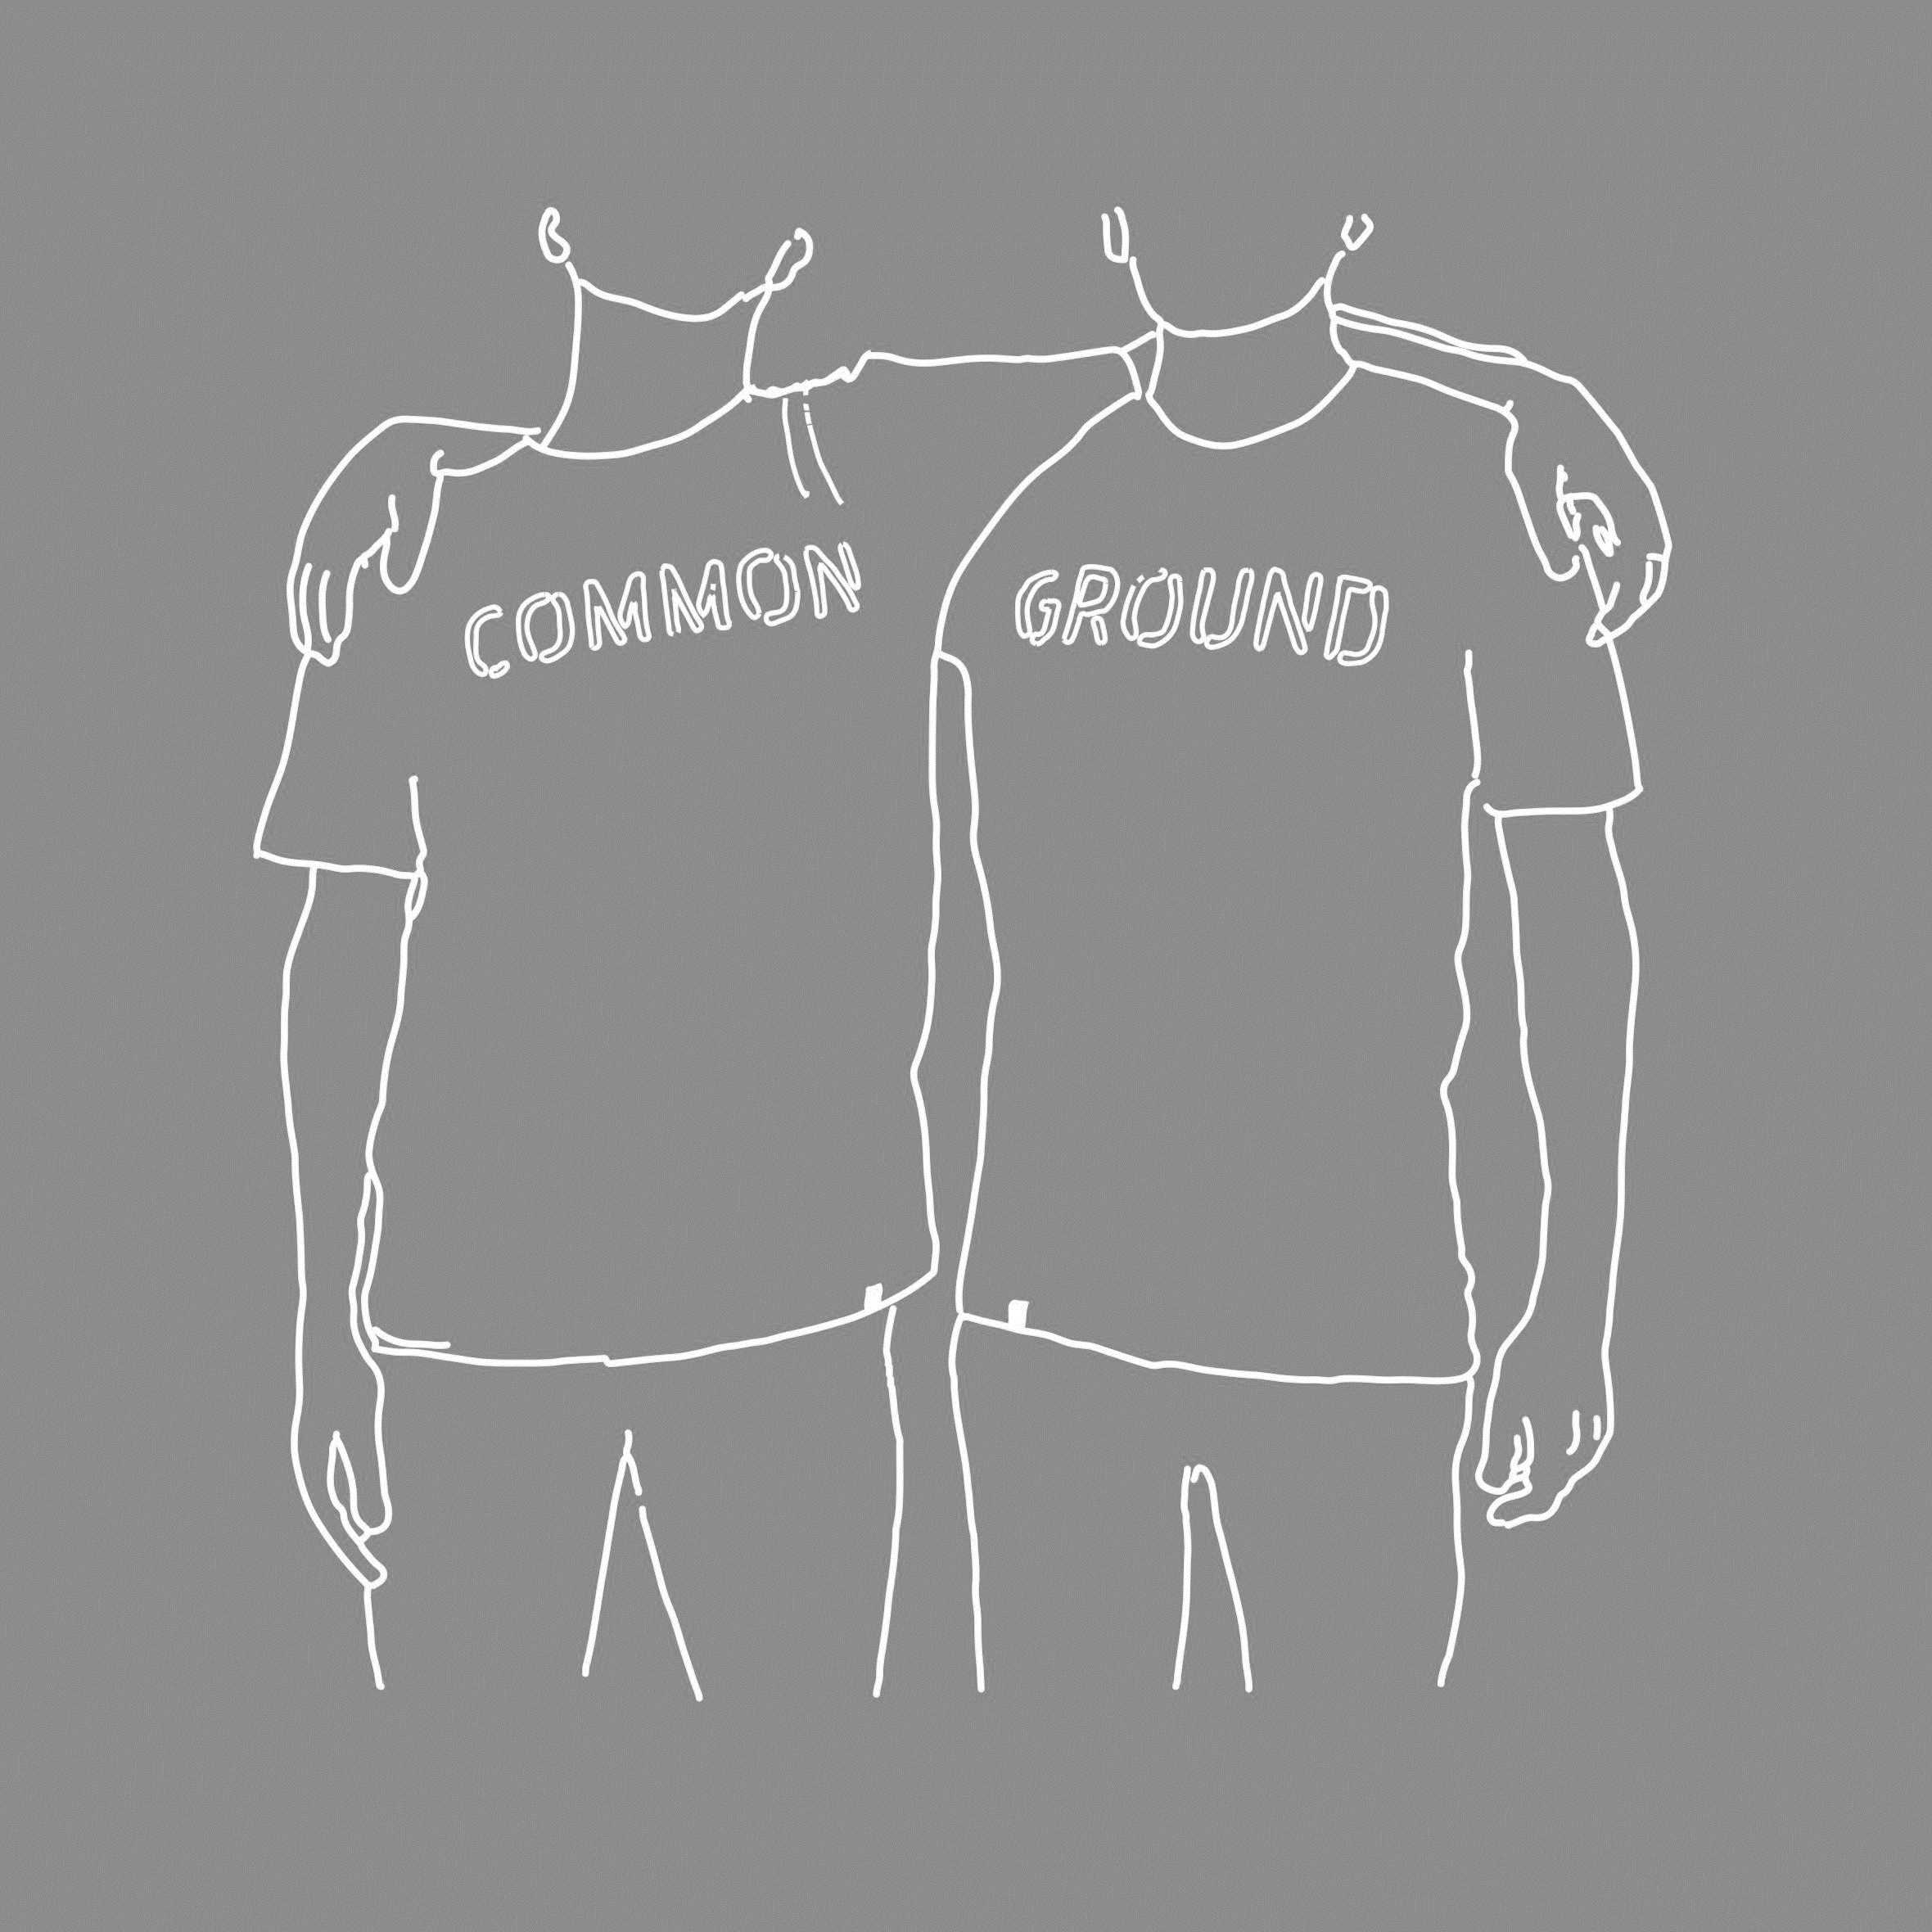
Build
“common ground”
Bharat
mane
Notes:
We know that we have two sides of brain,
Logical thinking side
Emotional thinking
How do we make decisions when we are faced with choices, what is that one that makes us believe A versus B
Science has revelled us that almost all kinds of decisions, the emotional side of the brain is predominant and stories speak to emotions

Slide 6
CONTRAST
Bharat
mane
Notes:
Build contrast, contrast is one of the most powerful devices in storytelling
Day-night, rich-poor, good-bad, hero-villain
It’s in the world of contrast that stories live
We need to bring something like what is versus what can be
Modi example
Don’t limit yourself to the contrast of problems & solutions which is again oblivious
This guy was operating from the place called sympathy
But what she did was empathy
What you can do and what I can’t
Draw and build on that contrast

Slide 7
Swachcha Bharat
Bharat
mane
Notes:
Modi Speech
https://youtu.be/JrKlYLxrGo4

Slide 8
PEOPLE WILL FORGET WHAT YOU SAID
Bharat
mane
Notes:
How you say something is as important as what you say

Slide 9
PEOPLE WILL FORGET WHAT YOU DID
Bharat
mane
Notes:
How you say something is as important as what you say

Slide 10
BUT PEOPLE WILL NEVER FORGET HOW YOU MADE THEM FEEL.
Bharat
mane
Notes:
How you say something is as important as what you say
Stories that come from falsehood have very short shelf life
Stories have to be authentic
Stories have to be truthful
They have to be based on facts
They have to be based on data
And data has to be truthful
As we saw in this example truth alone isn’t enough
That guy was telling the truth, I am blind please help, it doesn’t work
It needs to be stated beautifully
That’s why truth has to meet well told
And that well told is articulation
And that well told is presentation
And that well told is visualization
Is use of metaphor
Is use of contrast
Is use of anecdotes
Is use of emotions
When well told meets the well told then it becomes a story
There are people who said no to you and your friendship has broken and there are other who have told you no and you are still friends with them and the difference is how they said it
Use an example of performance appraisal, where boss would have been honest and he would have told everything and you would have come out crying and you would have hated him
And there is another boss he also would have stated the similar adequacies, but in a way that you come out and still want to work with him
It’s not what you said, but how you said would make all the difference

Slide 11
Don’t state the obvious
Bharat
mane
Notes:
When you can see that dubba there, you don’t have to say it…
Most of our presentations would be obvious,

Slide 12
Character + conflict + Resolution
Bharat
mane
Notes:
Central to the story is conflict
When there is no conflict there is no story
Boy loves girl,
Girl loves boy
And they live happily ever after
Nobody has hearsd that story
Nobody has written hat book
Nobody has seen that movie
But if Boy loves girl,
Girl loves boy
And father says, nahi ye shadi nahi ho sakati
If Lakshma would not have cut off the nose and left ear of shurpnaka we would not have Ramayana
If kouravasa have happily given what was belongs pandavas there would not have Mahabharata
If babuji would have agreed for Raj & Simaran there would not have DDLJ
If there is no conflict there is no story

Slide 14

What doesn’t work
The sales pitch
The ramble
ORG BORE
Inspiration perfromance
Bharat
mane
Notes:
The first is the ramble.
So many speakers think that they can just come and wing it.
They come under-prepared to a speaking occasion and they
just talk about one thing that's on
their mind and then they shift to another and they go,
oh, yes, and another thing that I just must mention before I stop
is and the audience doesn't know where they are heading.
There's no connection between these different parts.
The speaker may think that, hey,
all of this is interesting,
I'm an interesting person,
look at me, the audience experience is just one of deep frustration. Don't ramble.
You owe it to our audience to prepare a connected talk.

